Slide 1
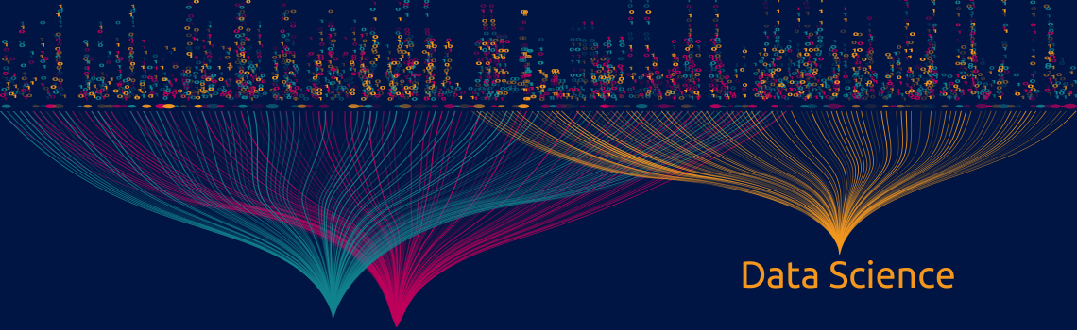
SEMESTER 1 – MACHINE LEARNING
FASHION – MNIST: Pixels speak style's language
Myrsini Karakasoglou
Antigoni Moira
Dimitris Tselentis

Slide 2

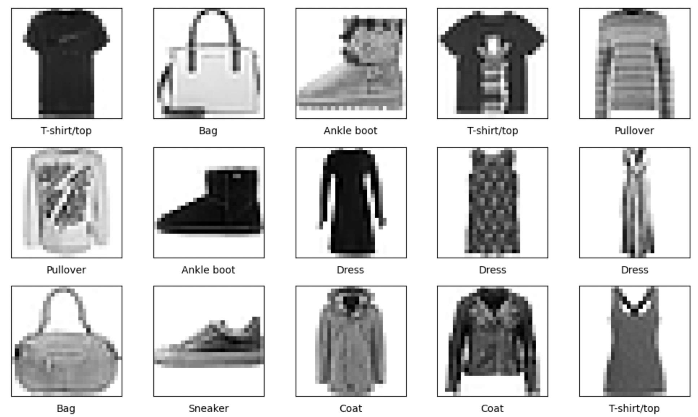
The Fashion-MNIST dataset
28 x 28 pixels
0 - T-shirt/top
1 - Trouser
2 - Pullover
3 - Dress
4 - Coat
5 - Sandal
6 - Shirt
7 - Sneaker
8 - Bag
9 - Ankle boot
784 features
pixel values: 0 - 255
60,000 training images
10,000 test images

Slide 3
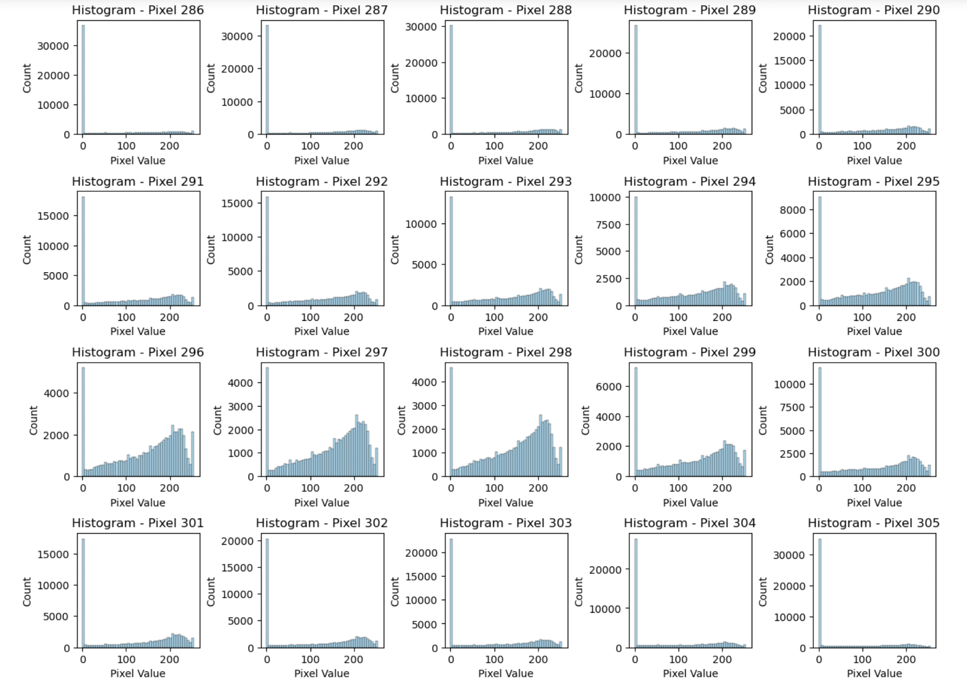
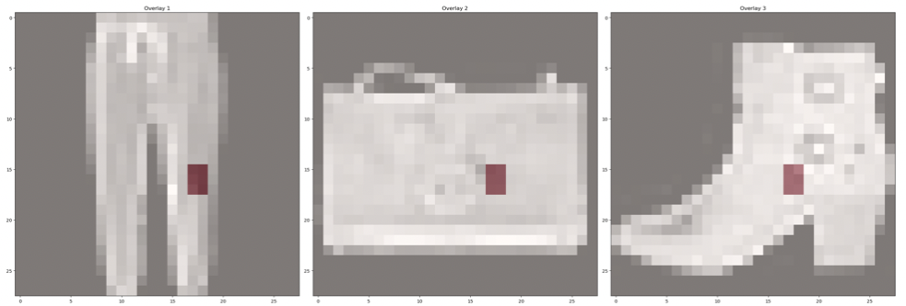
Locating some “informative” pixels
Uniform class distribution
pixel 437 | pixel 438 | pixel 465
pixel 466 | pixel 493 | pixel 494

Slide 4

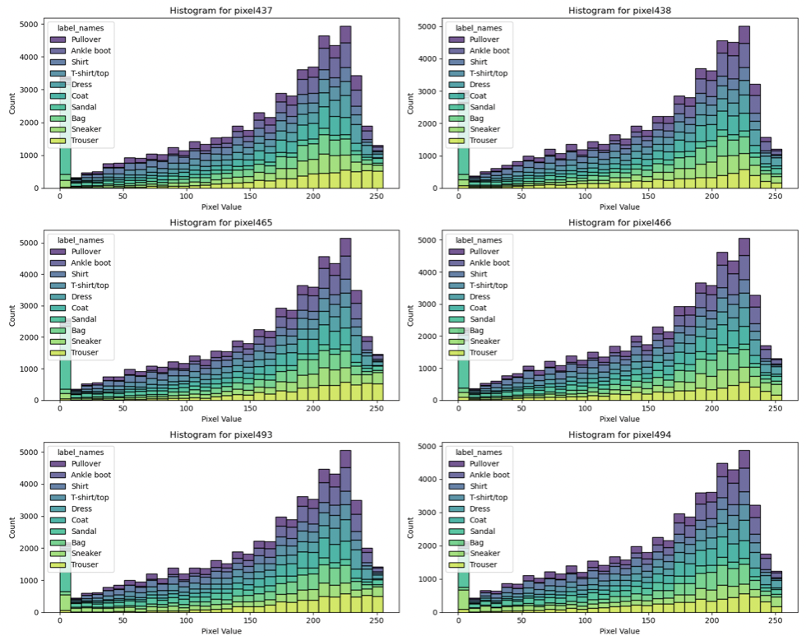
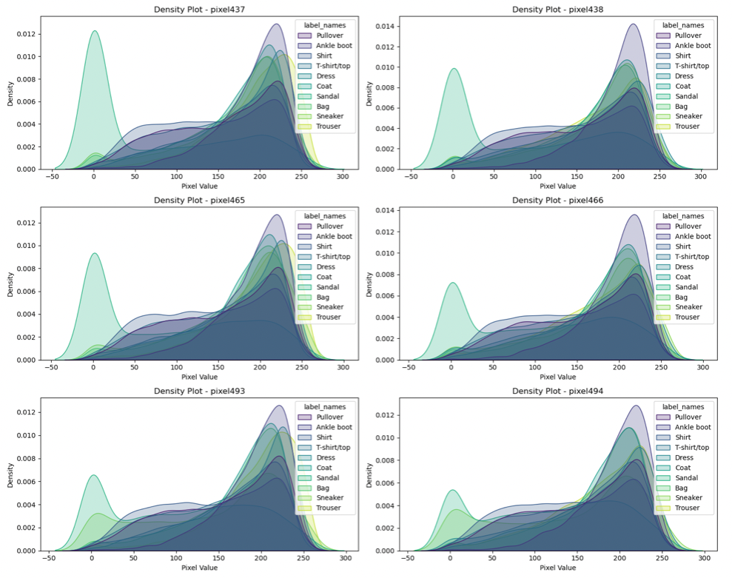
A peak into the “informative” features

Slide 5
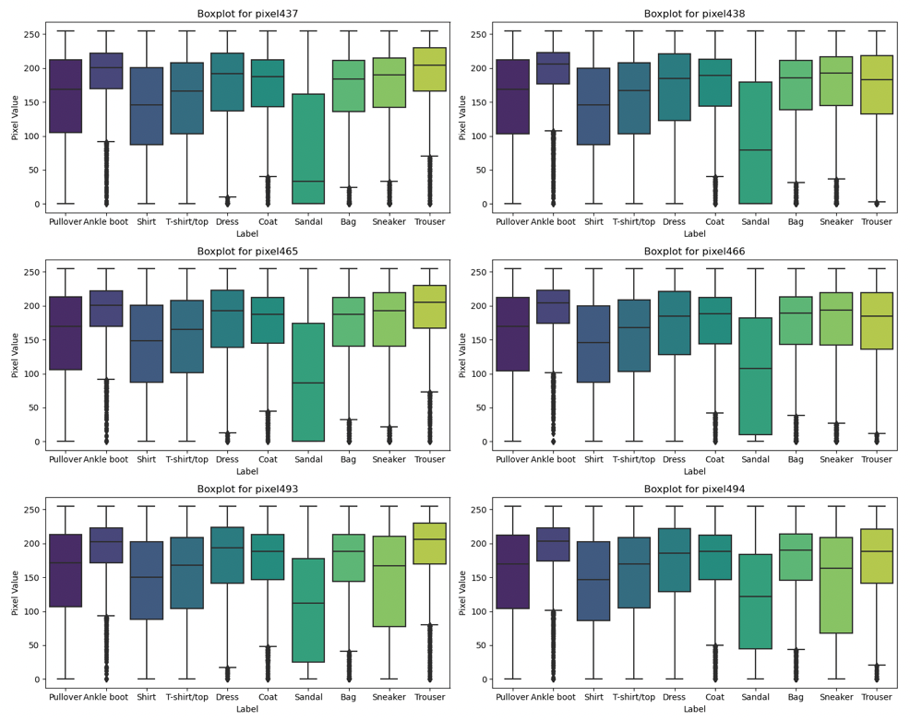
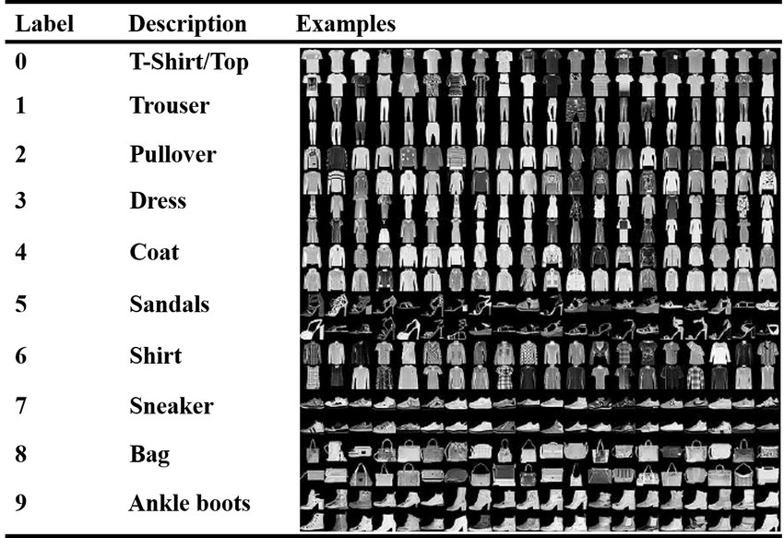
Further insights into the data...
Zhao, Jin & Jiao, Licheng. (2019). Sparse Deep Tensor Extreme Learning Machine for Pattern Classification. IEEE Access. PP. 1-1. 10.1109/ACCESS.2019.2924647.

Slide 6
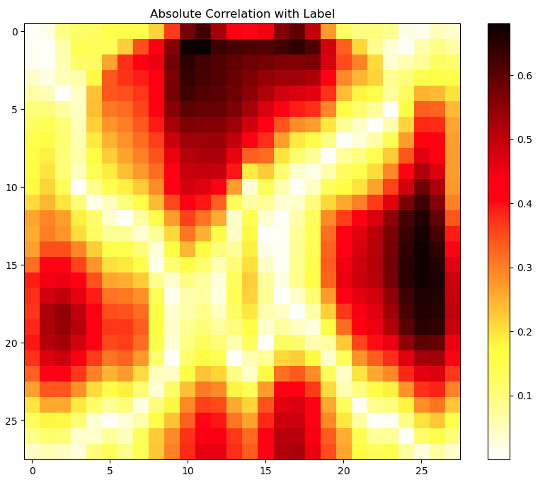
Locating important pixels...
Empty pixels?
Collectively correlated pixels?
Redundant pixels?

Slide 7
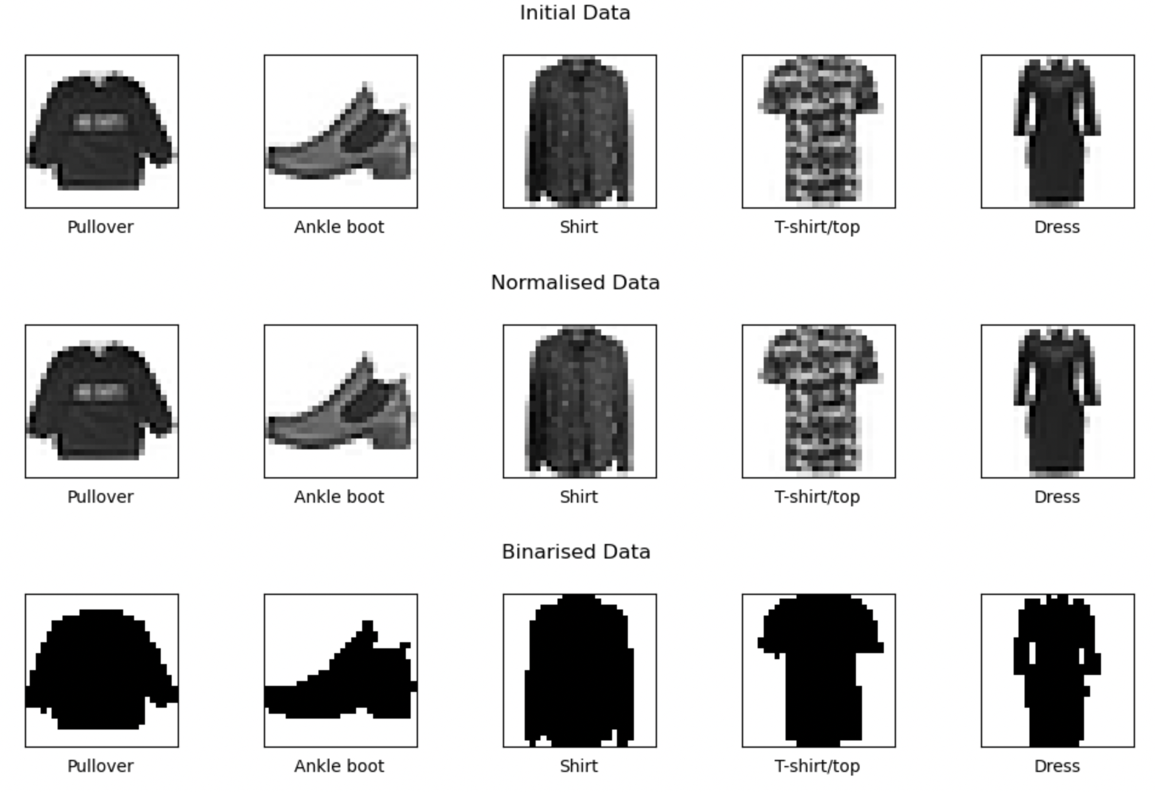
Get the data ready for the algorithms
no missing values
Normalisation → [0,1]
Binarisation → 0 or 1

Slide 8

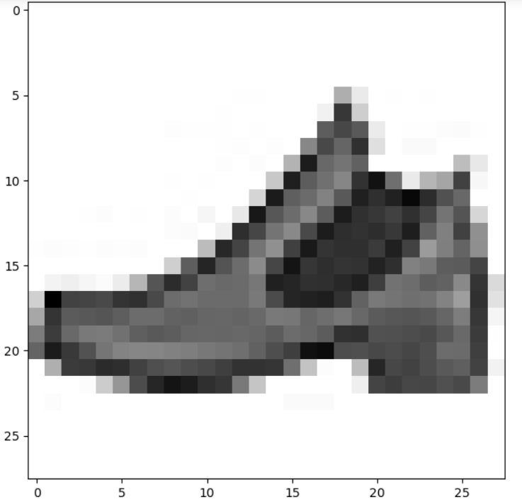
Locating “good” features
Irrelevant Pixels
Redundant Pixels

Slide 9
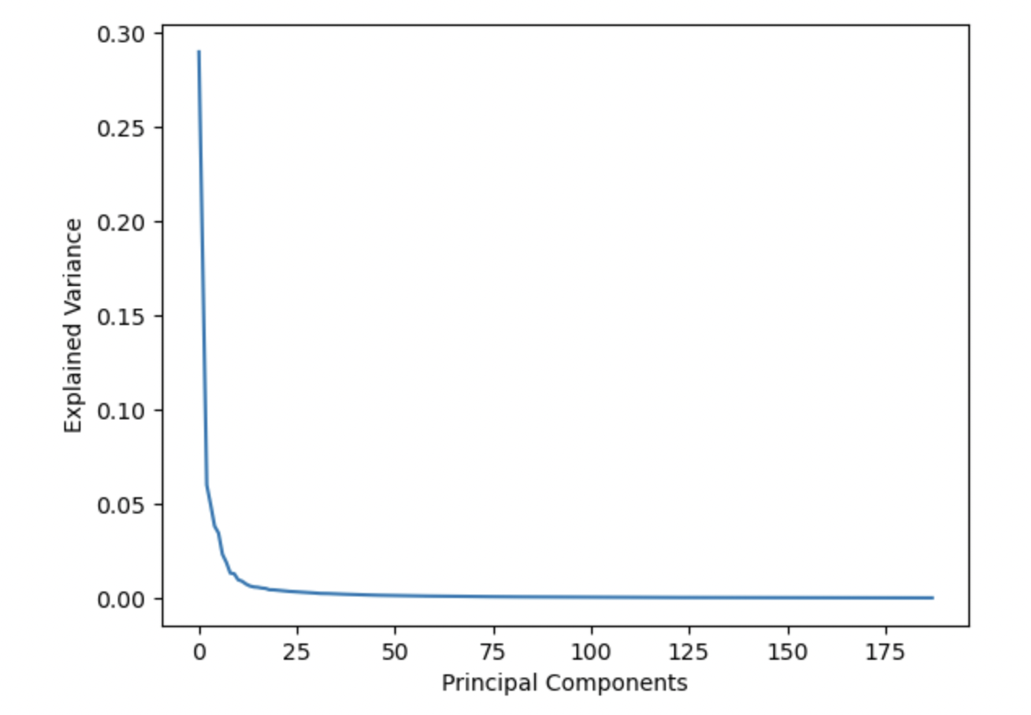
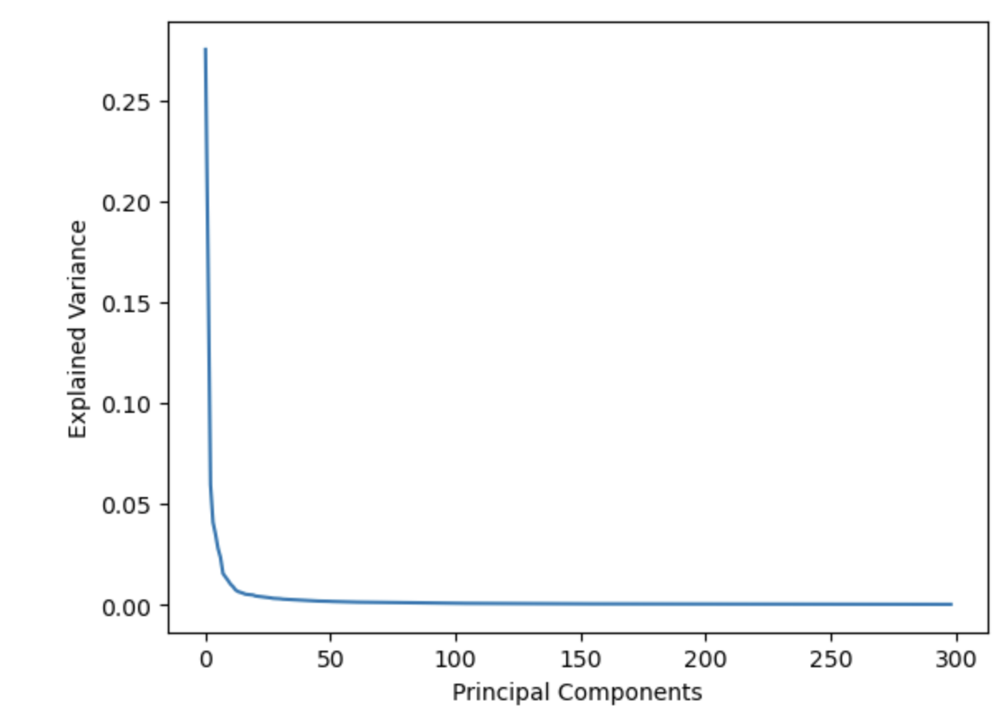
Feature Engineering – PCA ^{[1]}
Normalised Data
95% explained variance
Binarised Data
188
principal components
299
principal components

Slide 10
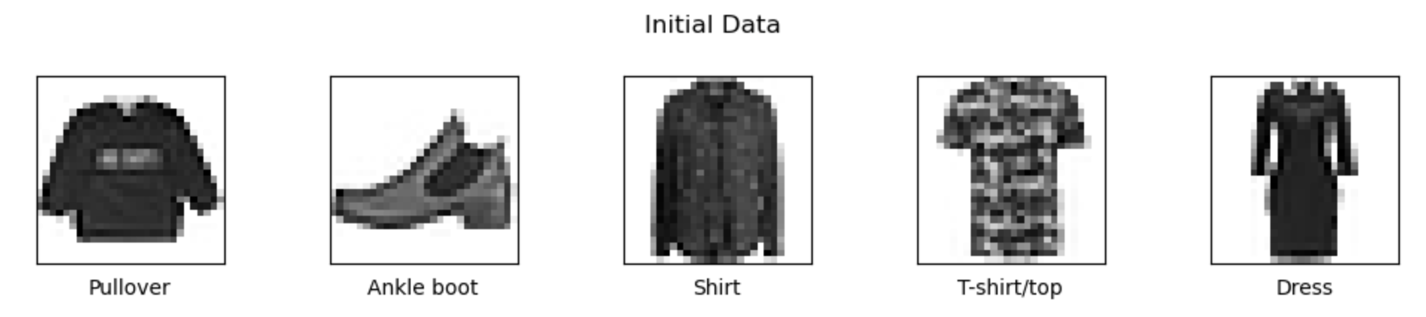
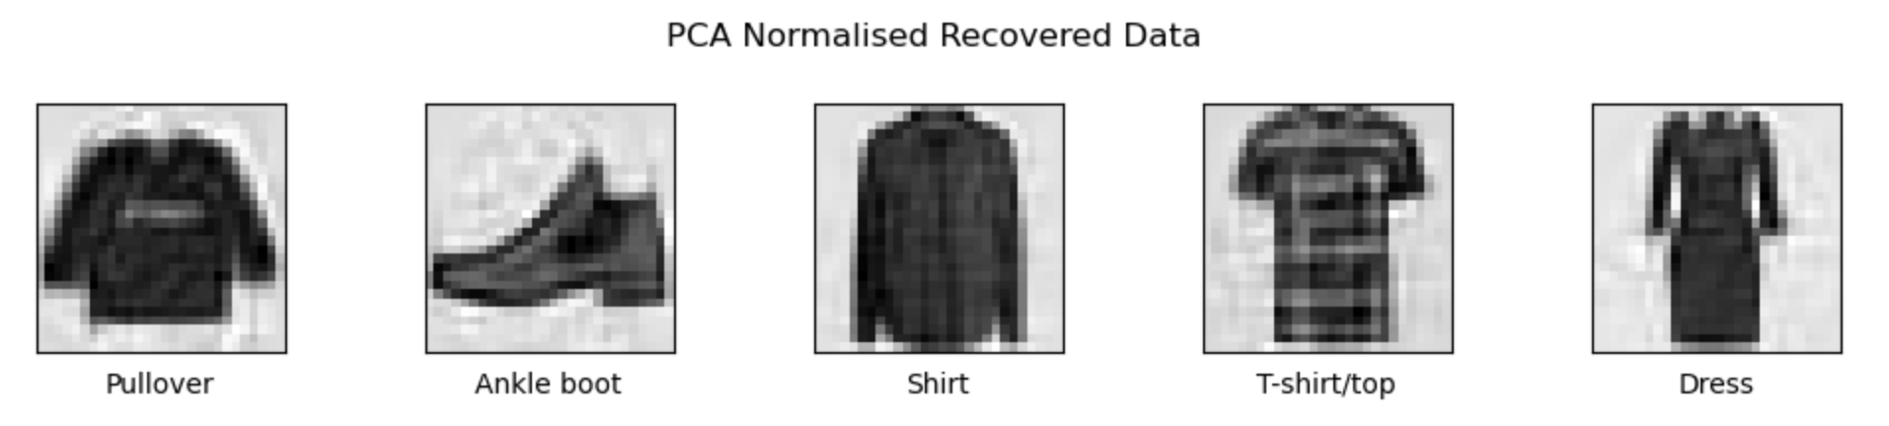
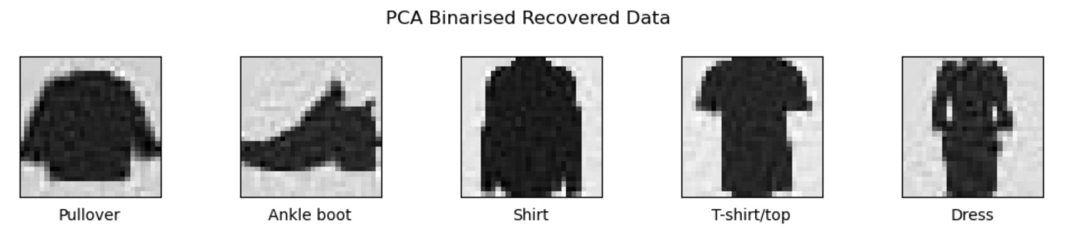
Feature Engineering – PCA ^{[2]}
95% explained variance
784 features
188
principal components
299
principal components

Slide 11




The algorithm selection phase
</>
Naïve Bayes
Logistic Regression
Decision Tree
kNN
SVM
Baseline data
Normalised data
Binarised data
Normalised selected data
Binarised selected data
Normalised PCA data
Binarised PCA data
5-fold validation
accuracy

Slide 12

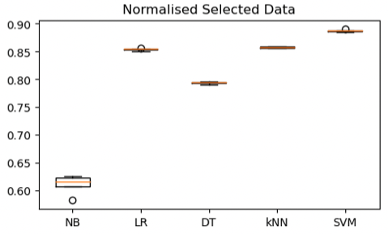
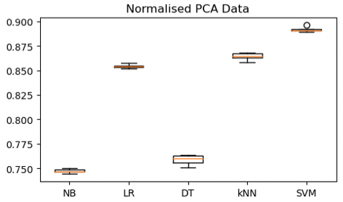
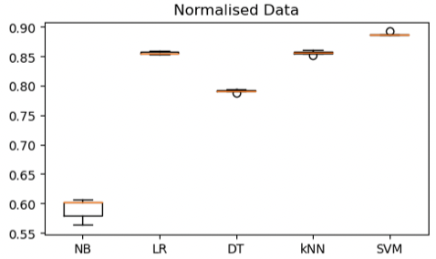
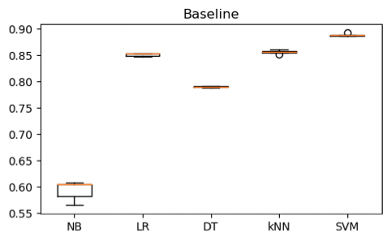
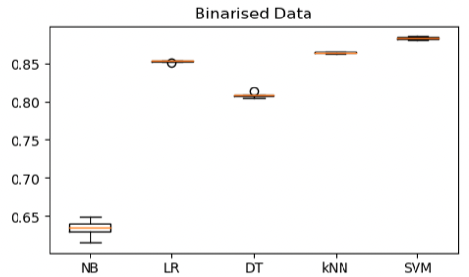
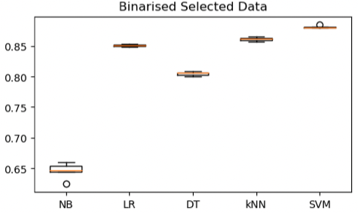
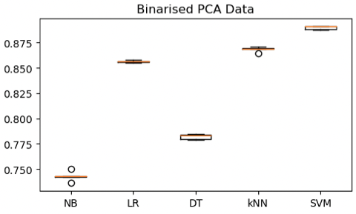

Comparing the algorithms
CONSTRAINTS
time
resources
SVM
normalised
PCA

Slide 13
Optimisation of SVM & Ensembles
Initial
performance
Acc ≈0.892
Random Forest
n_estimators: 200
min_samples_split: 10
min_samples_leaf: 2
max_features: sqrt
max_dept: 30
Criterion: gini
Bootstrap: false
Randomised Search
kernel: rbf
C: 10
XGBoost
Accuracy: ≈0.87
max_depth: 7
learning_rate: 0.3
lamda: 1
gamma: 0
colsample_bytree: 0.8
Accuracy: ≈0.905
Accuracy: ≈0.89

Slide 14
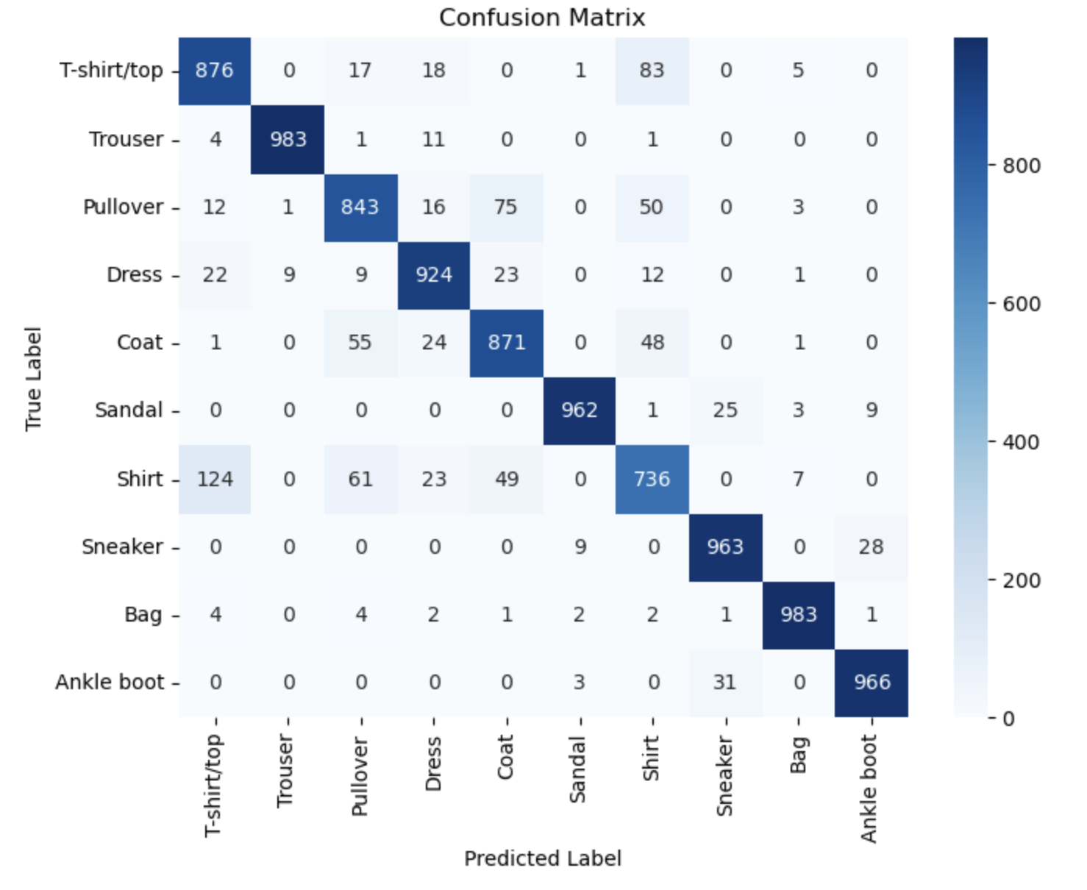
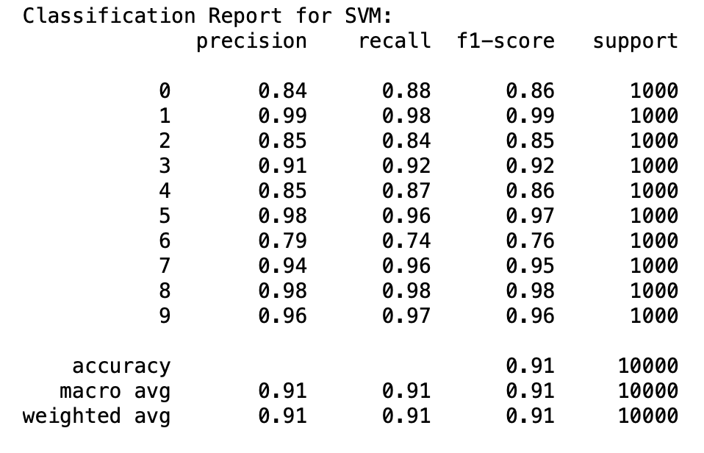
Testing the performance of tuned SVM
Normalised data
PCA (kernel: rbf, C: 10)
60,000 training images
10,000 test images

